Slide 1
IS 301 DECISION SUPPORT SYSTEMS
DECISION SUPPORT SYSTEMS AND INTELLIGENT SYSTEMS,
Seventh Edition
Efraim Turban, Jay E. Aronson, and Ting-Peng Liang
Chapter 0
Management Imation nforSystems
College of Computer Science and Information Technologe
Department of Computer Information Systems
Prof Dr. Taleb A. S. Obaid

Slide 2
Management Information Systems
Learning Objectives
What is Management Information Systems (MIS)
Capturing Data: Capturing contextual (appropriate) data, or operational information contribute in decision making.
Processing Data: needed for planning, organizing, coordinating, .. So, it means making calculations, sorting data, classifying data
Information Retrieval: The system should be able to retrieve this information from the storage as and when required by various users.
Information Propagation: the finished product of the MIS should be circulated to its users periodically using the organizational network.

Slide 3
Introduction (MIS)
For the manager is an implementation of the organizational systems and procedures.
To a programmer it is files structures and file processing.
The three components of MIS :
System suggests integration and holistic (complete) view,
Information stands for processed data, and
Management is the ultimate user, the decision makers.

Slide 4
Introduction (MIS)
Management
Management covers the planning, control, and administration of the operations of a concern.
the top management handles planning;
the middle management concentrates on controlling; and
the lower management is concerned with actual administration.
Information
means the processed data that helps the management in planning, controlling and operations.
Data means all the facts arising out of the operations of the concern.
System
A system is made up of inputs, processing, output and feedback or control.
Thus MIS means a system for processing data in order to give proper information to the management for performing its functions.

Slide 5
Characteristics of MIS
Definition
'MIS' is a planned system of collecting, storing, and disseminating data in the form of information needed to carry out the functions of management.
Characteristics of MIS
It should be based on a long-term planning.
It should provide a holistic view of the dynamics and the structure of the organization.
It should work as a complete and comprehensive system
It should be planned in a top-down way.
It should be based on need of strategic of managers of an organization.
It should take care of exceptional situations by reporting such situations.

Slide 6
Characteristics of MIS
It should be able to make forecasts and estimates, .. thus providing a competitive advantage.
It should create linkage between all sub-systems to get right decision
It should allow easy flow of information through various sub-systems, thus avoiding redundancy and duplicity of data.
Although the MIS is an integrated, complete system, it should be made in such a flexible way that it could be easily split into smaller sub-systems as and when required.
A central database is the backbone of a well-built MIS.

Slide 7
Characteristics of Computerized MIS
It should be able to process data accurately and with high speed.
It should be able to collect, organize, manipulate, and update large amount of raw data coming from various internal and external sources.
It should provide real time information without any delay.
It should support various output formats and follow latest rules and regulations in practice.
It should provide organized and relevant information for all levels.
It should aim at extreme flexibility in data storage and retrieval.

Slide 8
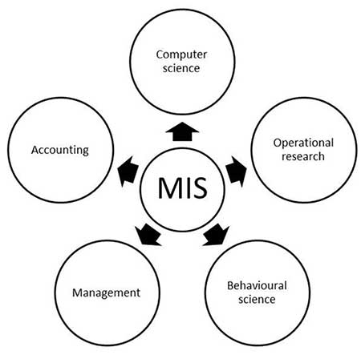
Nature and Scope of MIS
The following diagram shows the nature and scope of MIS:

Slide 9
MIS - Enterprise Resource Planning (ERP)
ERP is an integrated, real-time, cross-functional enterprise application, ... It supports all core business processes such as sales order processing, inventory management and control, production and distribution planning, and finance.

Slide 10
MIS - Enterprise Resource Planning (ERP)

Slide 11
MIS - Enterprise Resource Planning
ERP is an integrated, real-time, cross-functional enterprise application, an enterprise-wide transaction framework that supports all the internal business processes of a company.
It supports all core business processes such as sales order processing, inventory management and control, production and distribution planning, and finance.
Competitive advantage
Use of latest technologies

Slide 12
Why of ERP
ERP is very helpful in the following areas:
Business integration and automated data update
Linkage between all core business processes and easy flow of integration
Flexibility in business operations and more agility (quickly) to the company
Better analysis and planning capabilities
Critical decision-making

Slide 13
Scope of ERP
Finance: Financial accounting, managerial accounting, treasury management, asset management, budget control, costing, and enterprise control.
Logistics: Production planning, material management, plant maintenance, project management, events management, etc.
Human resource: Personnel management, training and development..
Supply Chain: Inventory control, purchase and order control, supplier scheduling, planning, etc.
Work flow: Integrate the entire organization with the flexible assignment of tasks and responsibility to locations, position, jobs, etc.

Slide 14
Advantages of ERP
Reduced quality costs
Quick decision-making
Forecasting and optimization
Better transparency

Slide 15
Disadvantage of ERP
Expense and time in implementation
Difficulty in integration with other system
Risk of implementation failure
Difficulty in implementation change
Risk in using one vendor
Use of latest technologies

Slide 16
MIS - Customer Relationship Management (CRM)
CRM is an enterprise application module that manages a company's interactions with current and future customers by organizing and coordinating, sales and marketing, and providing better customer services along with technical support.

Slide 17
Why CRM?
To keep track of all present and future customers.
To identify and target the best customers.
To let the customers know about the existing as well as the new products and services.
To provide real-time and personalized services based on the needs and habits of the existing customers.
To provide superior service and consistent customer experience.
To implement a feedback system.

Slide 18
Advantages of CRM
Provides better customer service and increases customer revenues.
Discovers new customers.
Cross-sells and up-sells products more effectively.
Helps sales staff to close deals faster.
Makes call centers more efficient.
Simplifies marketing and sales processes.

Slide 19
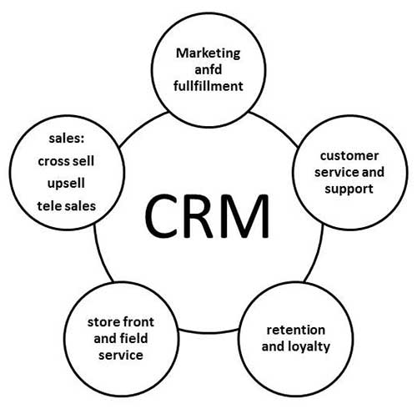
Disadvantages of CRM
Some times record loss is a major problem.
Overhead costs.
Giving training to employees is an issue in small organizations.

